Slide 1
Web Project
DESRAMAUT FICOT LAMBEC SAUVAGE

Slide 2
Table of contents
Project presentation
Team presentation
Presentation of the website
Functionalities
Improvement points
Conclusion

Slide 3
Analysis
Create a website for the student’s office of the school
Build an online shop for their goodies
Create a special page for incomings events and previous ones

Slide 4
Team presentation
Paul FICOT
Nathan LAMBEC
Team manager
NodeJS Expert
Laravel Expert
Database expert
Notes:
Henri + Simon

Slide 5
Team presentation
Axel SAUVAGE
Antoine DESRAMAUT
PHP Expert
Javascript Expert
HTML CSS Expert
Legal Expert
Notes:
Vincent + Paul

Slide 6
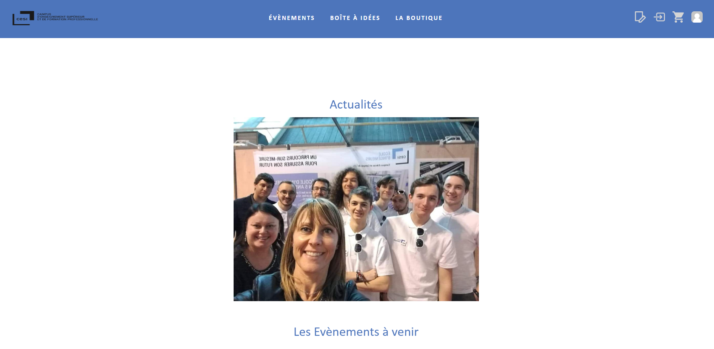
Presentation of the website | Host

Slide 7
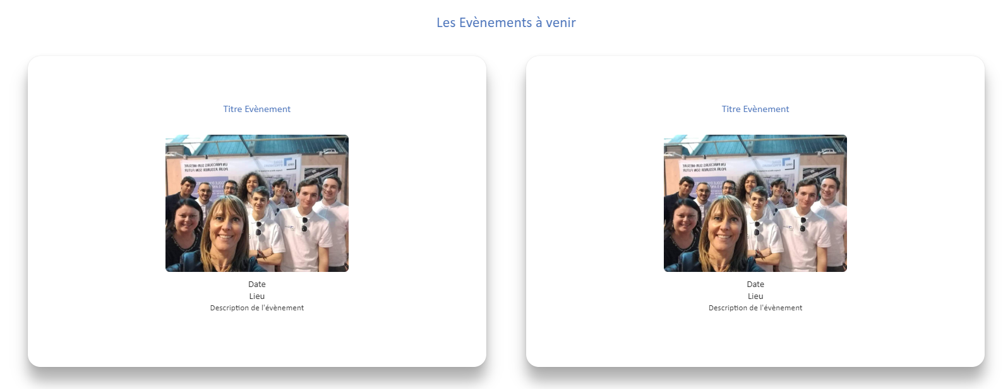
Presentation of the website | Host

Slide 8
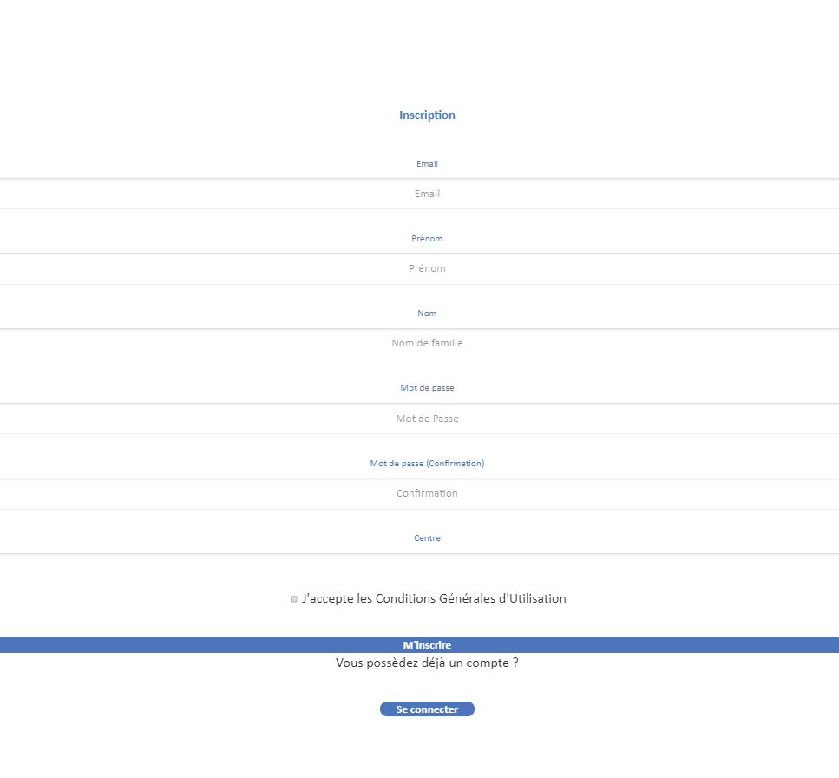
Presentation of the website | Host

Slide 9
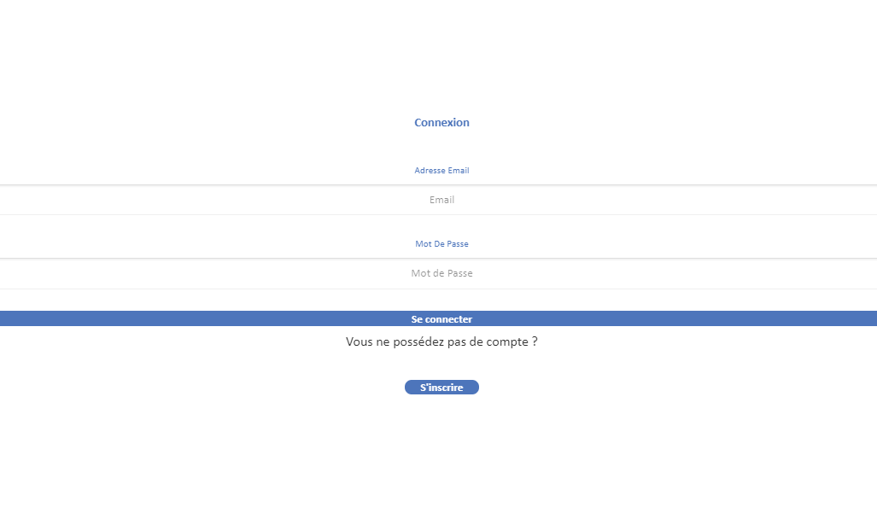
Presentation of the website | Host

Slide 10
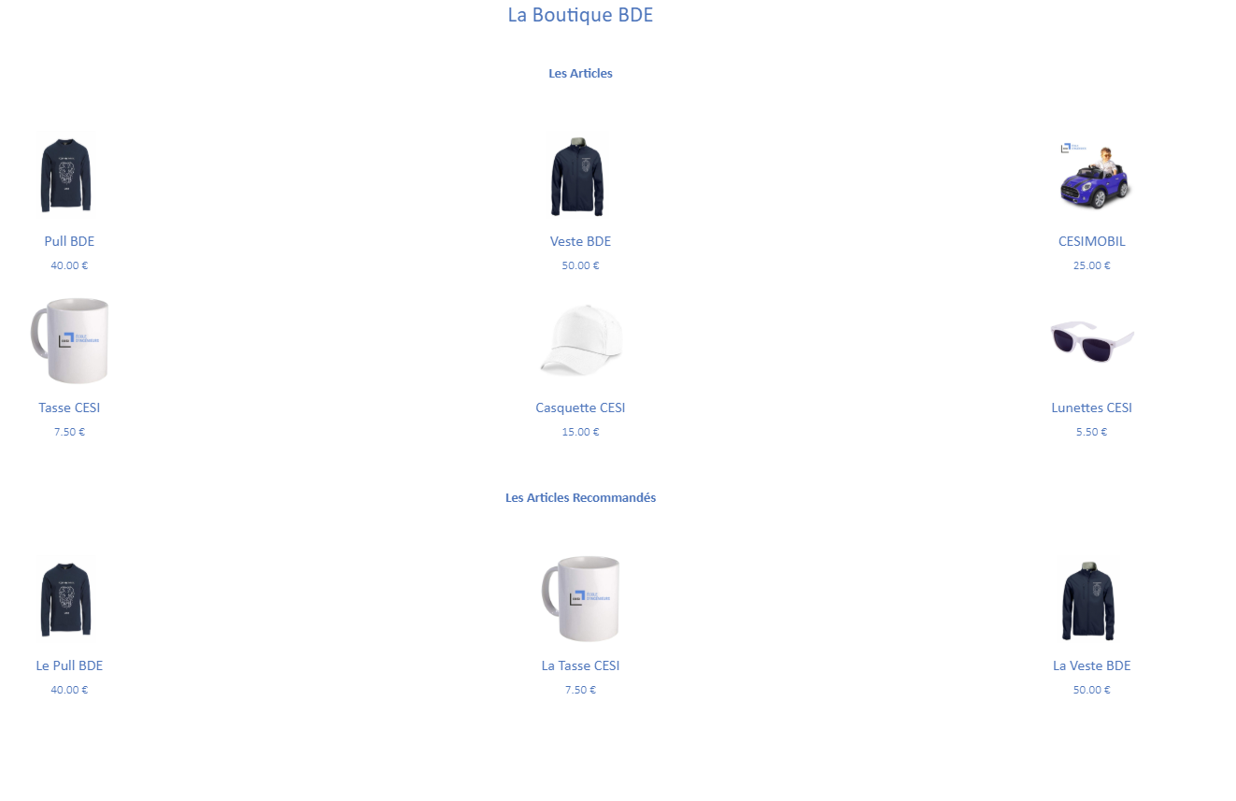
Presentation of the website | Events

Slide 11
Presentation of the website | Ideabox

Slide 12
Presentation of the website | Shop

Slide 13
Presentation of the website | Legal notice

Slide 14
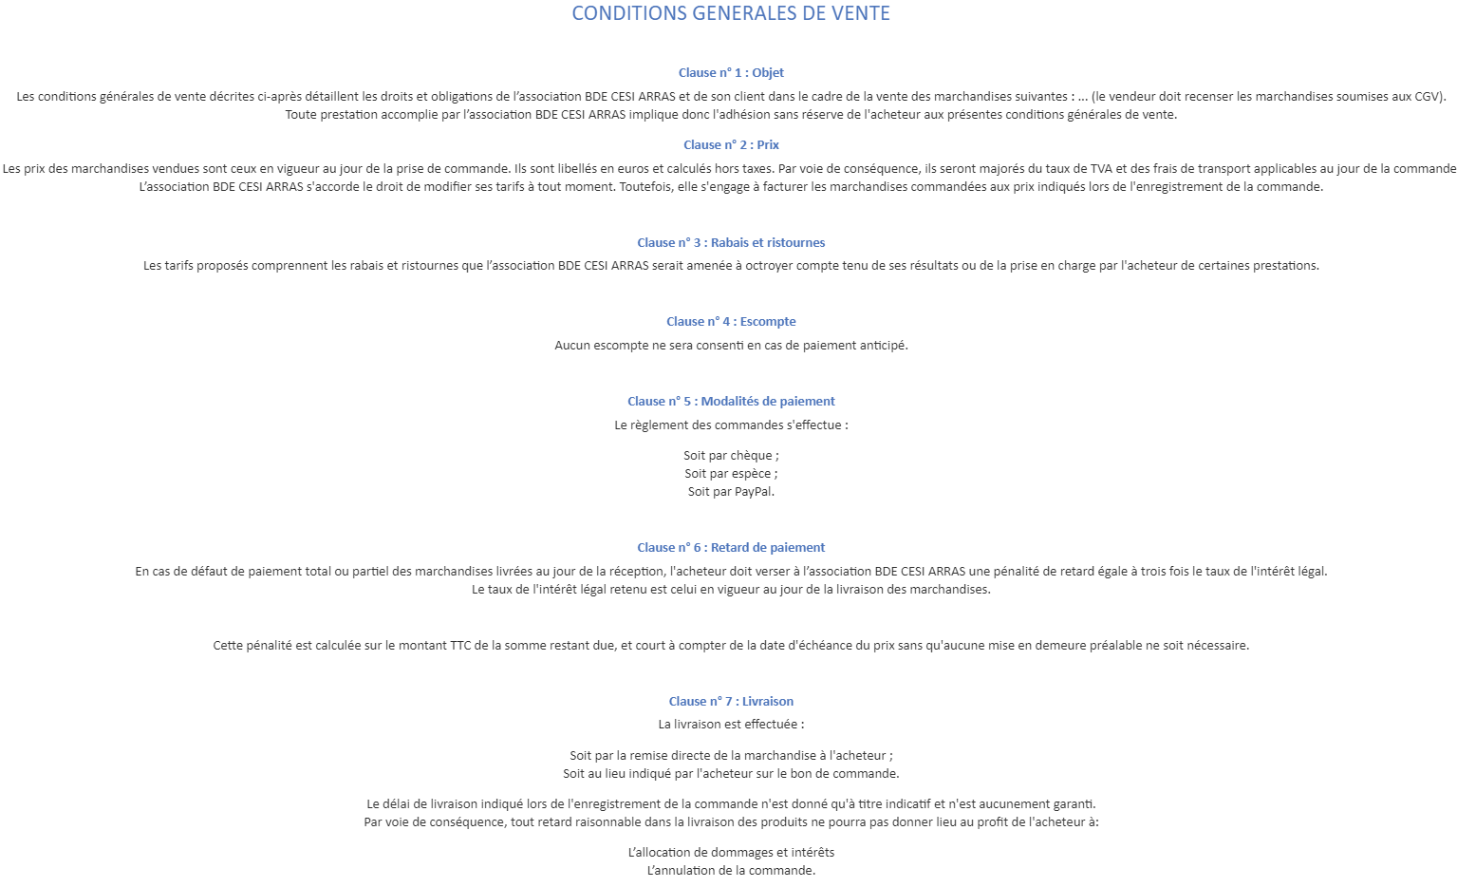
Presentation of the website | Terms and conditions

Slide 15
Presentation of the website | Terms

Slide 16
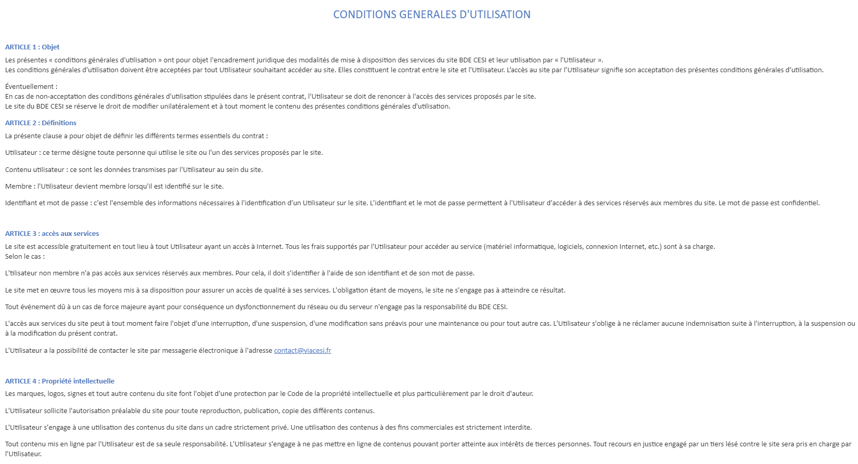
Presentation of the website | Terms of service

Slide 17
Functionalities | Regular student
Functionnalities | Work done
Sign in | Done
Log in | Done
Log out | Done
Go on all the site without being able to buy | Not done

Slide 18
Functionalities | Connected student
Functionalities | Work done
Subscribe to an activity | Not done
Access the idea box | Done
Vote for an event | Not done
Suggest an event | Not done
Add pictures to previous events I subscribed | Not done
Comment and like pictures | Not done

Slide 19
Functionalities | Member of student’s office
Functionalities | Work done
Post an event with a description, an image and a date | Not done

Slide 20
Functionalities | CESI Employees
Functionalities | Work done

Slide 21
Functionalities | Shop
Functionalities | Work done

Slide 22
Improvement points

Slide 23
Conclusion
A
A
A

